Slide 1
STATISTICAL RESEARCH REPORT
2026 · SPRING
A STUDY IN BEHAVIOR, PERFORMANCE & WELLBEING
Students'
Lifestyle &
Academic
Performance.
An inferential and model-based analysis of 2,000 students — examining how study habits, sleep, social life, and physical activity shape GPA and stress.
Al Khattab Al Saqri
ID · 138349

Slide 2
INTRODUCTION
02 / 28
CONTEXT & MOTIVATION
Why lifestyle meets learning
Students' academic performance is shaped by a combination of behavioral and lifestyle factors — study habits, sleep patterns, social engagement, and physical activity.
PRIMARY OBJECTIVE
Explain & predict.
Apply appropriate inferential procedures and advanced statistical modeling to evaluate how lifestyle factors explain and predict academic performance and stress levels.
These factors influence not only outcomes like GPA, but also psychological wellbeing, often reflected through stress levels.
From a statistical perspective, this dataset offers a chance to apply both inferential and model-based techniques to mixed continuous/categorical real-world data — testing hypotheses, validating assumptions, and building predictive models.
EMPHASIS
Selecting suitable methods · validating assumptions · interpreting results in the context of student life.

Slide 3
FRAMING
03 / 28
THE INQUIRY
Research Questions
Six questions guide the entire analysis — from correlation and group differences to classification and clustering.
01
Is there a significant relationship between study hours and academic performance (GPA)?
02
How do lifestyle factors ( sleep, social, physical activity ) relate to students' GPA?
03
Do students with different stress levels (low, medium, high) differ significantly in their lifestyle habits?
04
Is there a statistically significant association between lifestyle variables and stress level?
05
Can students' stress levels be accurately predicted using lifestyle variables?
06
Are there distinct groups of students based on their lifestyle patterns?

Slide 4
METHODS
04 / 28
CHOSEN STATISTICAL TECHNIQUES
Four methods, one question each
INFERENTIAL · BIVARIATE
INFERENTIAL · GROUP COMPARISON
Pearson's Correlation
One-Way ANOVA
Tests the strength and direction of a linear relationship between two continuous variables.
Tests whether the means of a continuous variable differ across 3+ categorical groups.
r = Σ(xᵢ − x̄)(yᵢ − ȳ) / √[Σ(xᵢ − x̄)² Σ(yᵢ − ȳ)²]
F = MS(between) / MS(within)
Used for: Study Hours ↔ GPA, and the continuous-variable correlation matrix. Chosen because both variables are continuous and the scatter plot suggests linearity.
Used for: Comparing each lifestyle/academic variable across Low / Moderate / High stress. Chosen because Stress Level has three unordered groups and the outcomes are continuous.
MODELING · CLASSIFICATION
MODELING · UNSUPERVISED
Logistic Regression
K-Means Clustering
Models a binary outcome as a function of multiple predictors via the logit link.
Partitions observations into k groups that minimize within-cluster variance.
logit(p) = log(p / (1 − p)) = β₀ + β₁x₁ + ... + βₖxₖ
argmin Σᵢ Σ(x ∈ Cᵢ) ‖x − μᵢ‖²
Used for: Predicting High vs. Low/Moderate stress from lifestyle + GPA. Chosen because the outcome is categorical and a linear model on probabilities would violate the [0,1] constraint.
Used for: Discovering natural student lifestyle profiles without using labels. Chosen because it scales well, is interpretable, and works on standardized continuous predictors.

Slide 5
SECTION ONE
0
Exploratory Data Analysis
Inspecting, cleaning, and understanding the data

Slide 6
EDA · STRUCTURE
06 / 28
DATASET OVERVIEW
Eight columns, two thousand rows
OBSERVATIONS
VARIABLES
OUTCOME
GROUPING
2,000
8
GPA
Stress Level
one row per student
7 numeric · 1 categorical
continuous [2.24, 4.00]
Low · Moderate · High
CONTINUOUS · PREDICTOR
CONTINUOUS · PREDICTOR
CONTINUOUS · PREDICTOR
Study Hours
Sleep Hours
Social Hours
Daily time spent studying. Range 5–10 hrs, mean ≈ 7.48.
Average daily sleep. Range 5–10 hrs, mean ≈ 7.50.
Time on social activities. Range 0–6 hrs, mean ≈ 2.70.
CONTINUOUS · PREDICTOR
CONTINUOUS · OUTCOME
CATEGORICAL · OUTCOME
Physical Activity
GPA
Stress Level
Time on exercise. Range 0–13 hrs, mean ≈ 4.33.
Grade Point Average, academic performance measure.
Self-reported stress: Low, Moderate, High.

Slide 7
EDA · DATA QUALITY
07 / 28
MISSING VALUES · MICE IMPUTATION
Sixty-four gaps, thoughtfully filled
64 missing values spread across 7 variables — moderate in proportion but too scattered to safely drop rows.
Why MICE?
Social Hours
18
Multivariate Imputation by Chained Equations generates statistically sound, unbiased estimates while using all the available information.
Extracurricular
17
Sleep Hours
15
Preserves relationships — imputes each missing value from a predictive model of the other variables.
Physical Activity
7
Study Hours
4
Reflects uncertainty — produces multiple imputed datasets; standard errors are not artificially shrunken.
GPA
2
Stress Level
1
Handles mixed types — continuous (hours, GPA) and categorical (Stress Level) together.
Avoids row deletion — keeps the full sample size and statistical power.

Slide 8
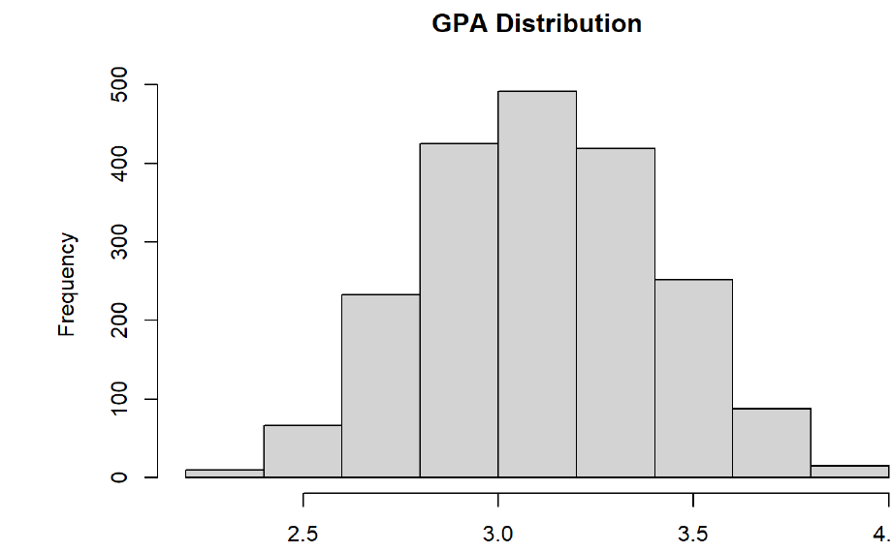
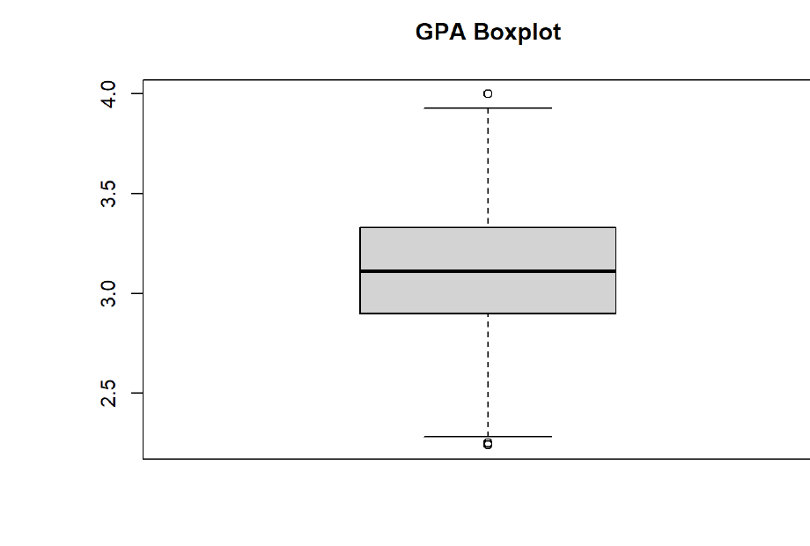
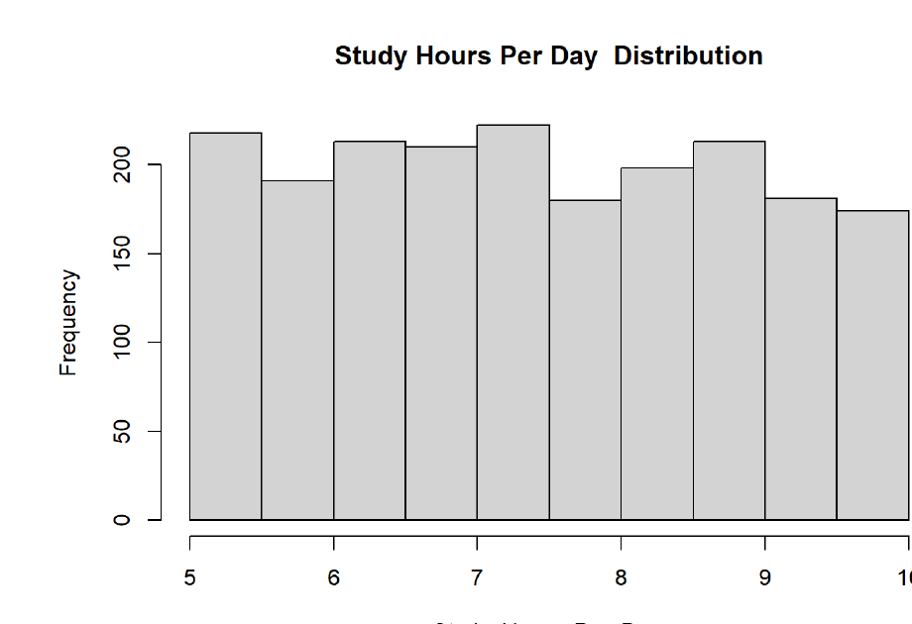
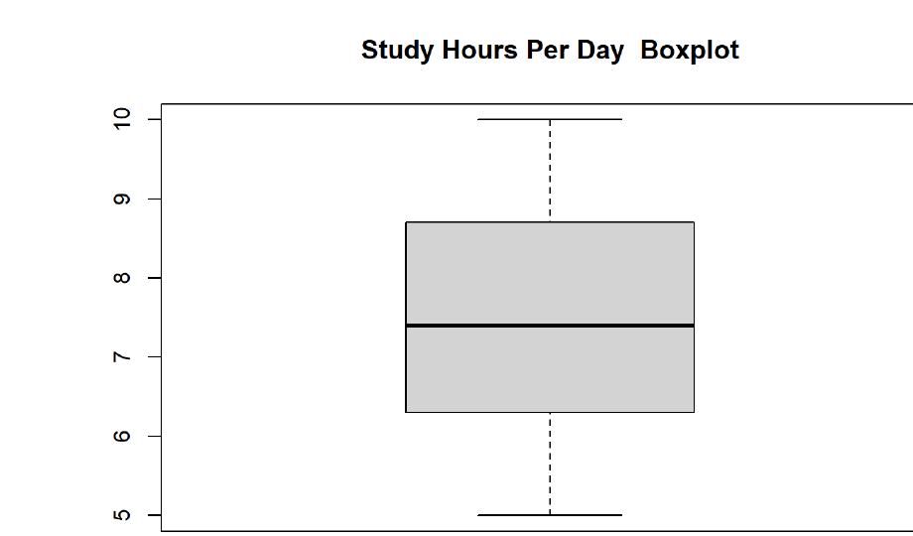
EDA · UNIVARIATE
08 / 28
CONTINUOUS VARIABLES · PART 1
GPA & Study Hours in shape
GPA Distribution
μ = 3.116 · med = 3.11
GPA Boxplot
IQR: 2.90 — 3.33
SYMMETRIC · NORMAL-LIKE
STABLE & RELIABLE
Range 2.24–4.00. Histogram is bell-shaped; mean ≈ median confirms symmetry. No meaningful outliers.
Balanced whiskers, tight IQR. Data is well-behaved and suitable for parametric tests downstream.
Study Hours Distribution
μ = 7.48 · med = 7.40
Study Hours Boxplot
IQR: 6.30 — 8.70
UNIFORM-LIKE
NO OUTLIERS
Range 5–10 hrs. Bars are nearly even across the range — students distribute study time broadly.
Symmetric around the median; no skewness. Middle 50% spans a realistic 2.4-hour window.

Slide 9
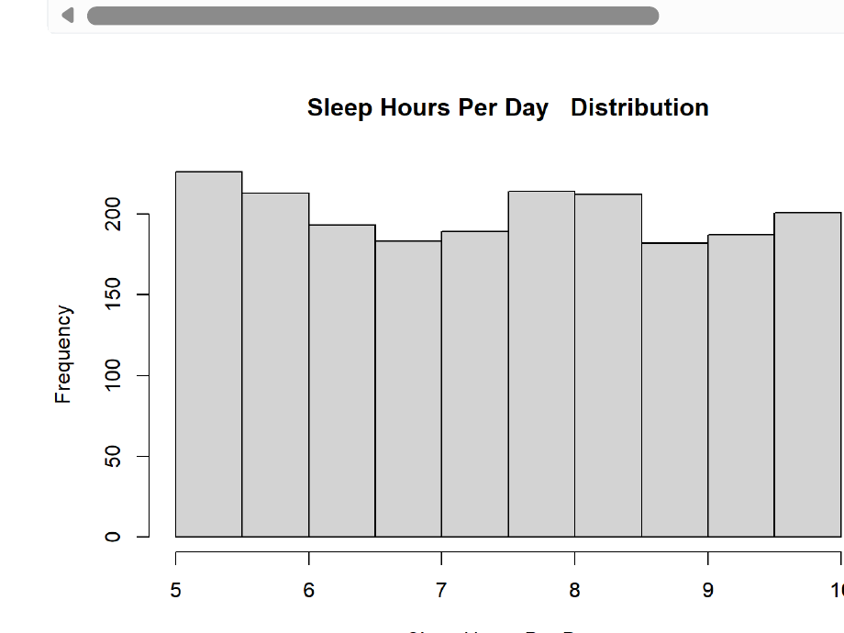
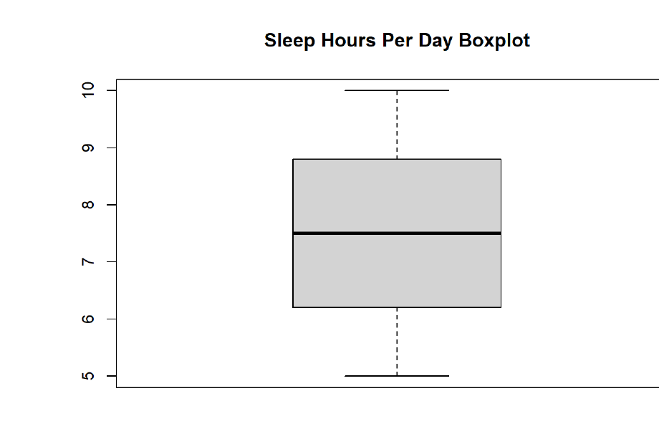
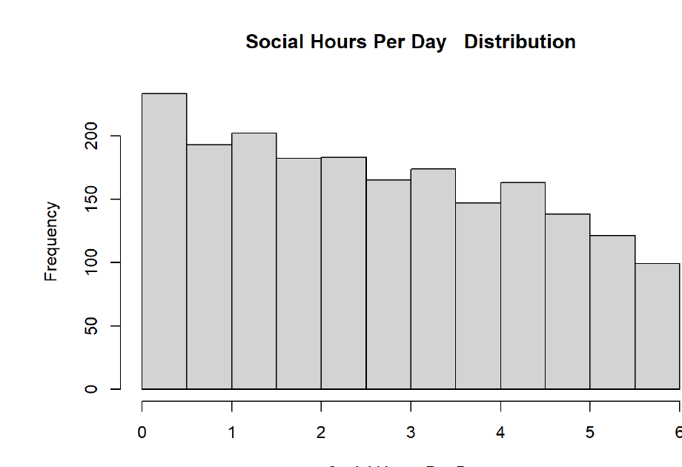
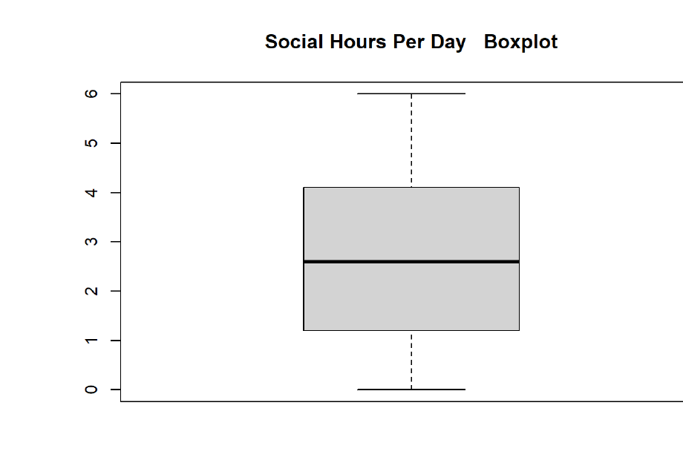
EDA · UNIVARIATE
09 / 28
CONTINUOUS VARIABLES · PART 2
Sleep & Social Hours
Sleep Hours Distribution
μ = 7.50 · med = 7.50
Sleep Hours Boxplot
IQR: 6.20 — 8.80
HIGHLY SYMMETRIC
BALANCED · NO OUTLIERS
Range 5–10 hrs. Mean equals median almost exactly — distribution is clean and well-behaved.
Equal whisker lengths, symmetric IQR. Consistent sleep patterns across the sample.
Social Hours Distribution
μ = 2.70 · med = 2.60
Social Hours Boxplot
IQR: 1.20 — 4.10
RIGHT-SKEWED
UPPER WHISKER LONGER
Range 0–6 hrs. Most students cluster at lower social hours; a long tail of higher-engagement students.
Confirms the right-skew. No formal outliers, but the distribution reaches upward more than downward.

Slide 10
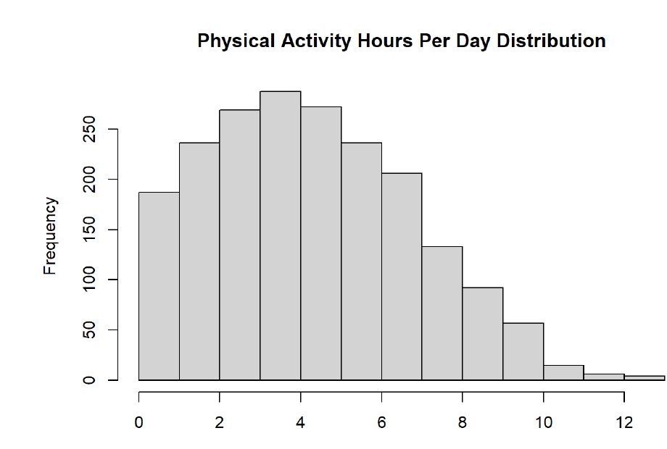
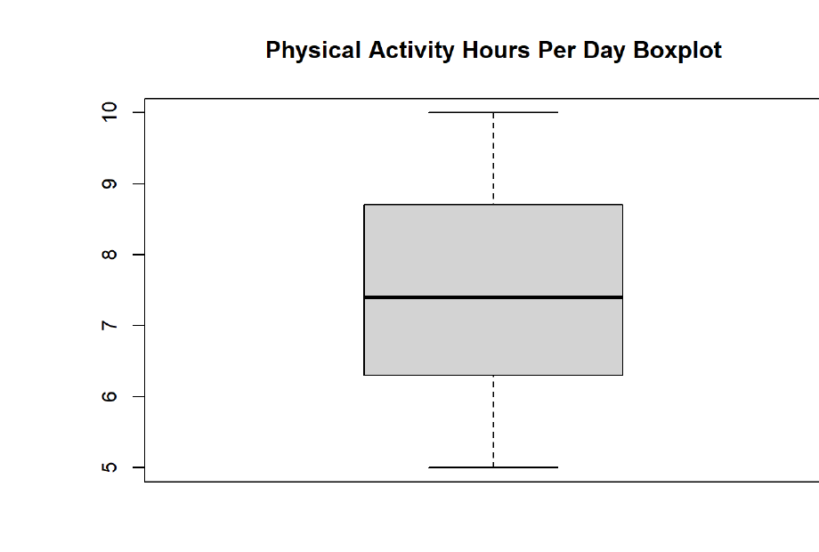
EDA · UNIVARIATE
10 / 28
CONTINUOUS VARIABLES · PART 3
Physical Activity
Distribution
μ = 4.33 · med = 4.10
Boxplot
IQR: 2.40 — 6.10 · max 13
MILD RIGHT-SKEW · WIDER SPREAD THAN OTHER VARIABLES
Range 0–13 hours — the widest of any continuous variable. Mean (4.33) exceeds the median (4.10), and the upper whisker is longer. Most students cluster at moderate levels, with a smaller group engaging in much heavier activity. No formal outliers.

Slide 11
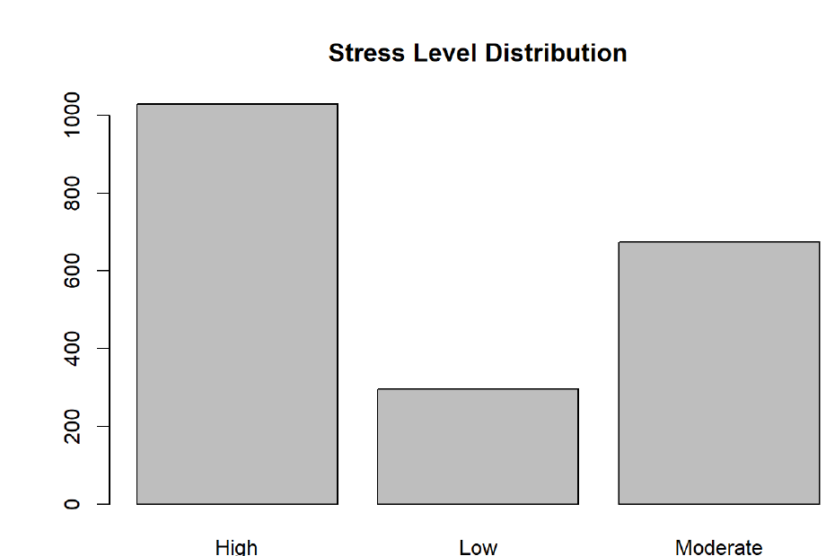
EDA · UNIVARIATE
11 / 28
CATEGORICAL VARIABLE
Stress Level imbalance
HIGH STRESS
1,029
51.5%
MODERATE STRESS
674
33.7%
LOW STRESS
296
14.8%
KEY OBSERVATION
Over half the students are in the High stress category — a striking concentration that previews one of the study's central findings.
FIG. — BAR CHART OF STRESS LEVEL FREQUENCIES

Slide 12
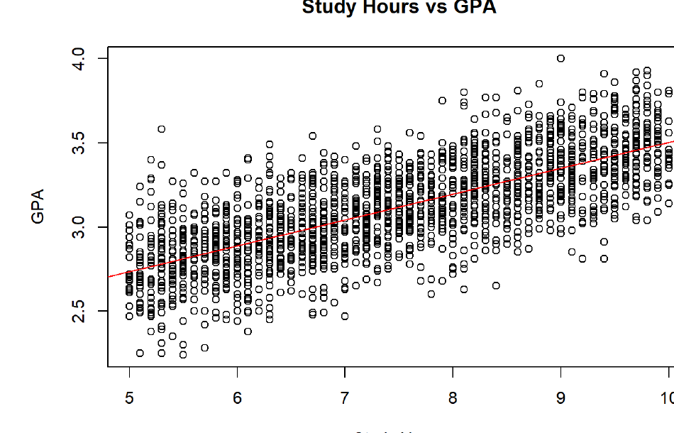
EDA · BIVARIATE
12 / 28
CONTINUOUS × CONTINUOUS
First look: Study Hours vs. GPA
A clear positive trend.
The fitted regression line rises from bottom-left to top-right — more study time tends to mean a higher GPA. But the scatter is wide: students with similar study hours land at noticeably different GPAs.
Study time is a strong predictor, but not the only one.
Sleep, stress, social life, and physical activity likely explain the residual variation.
This visual motivates the Pearson correlation test in Part I.
FIG. — SCATTER WITH FITTED LINEAR REGRESSION

Slide 13
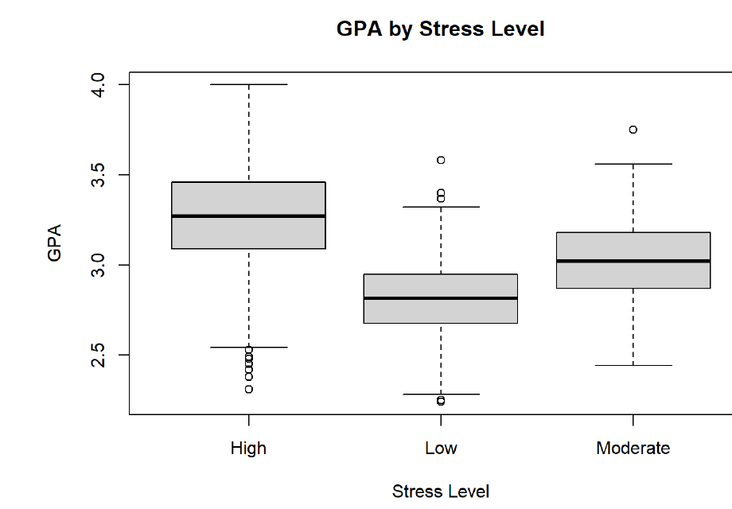
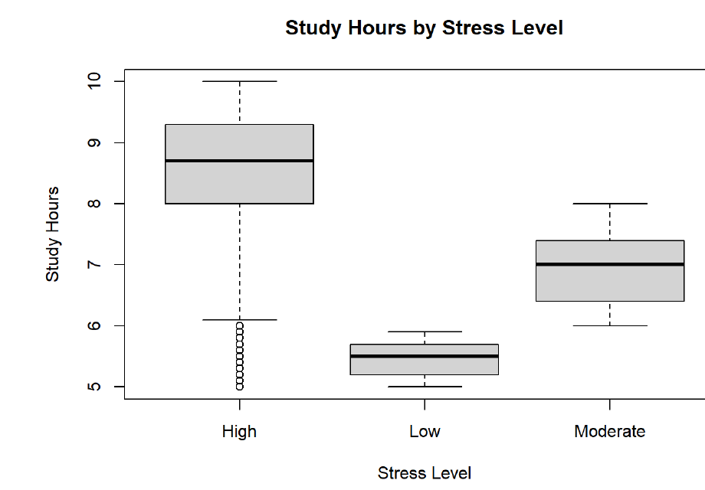
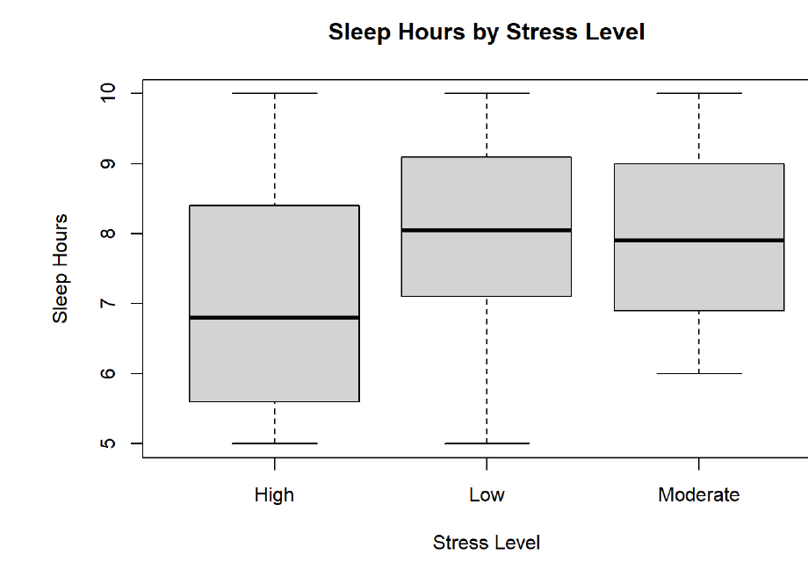
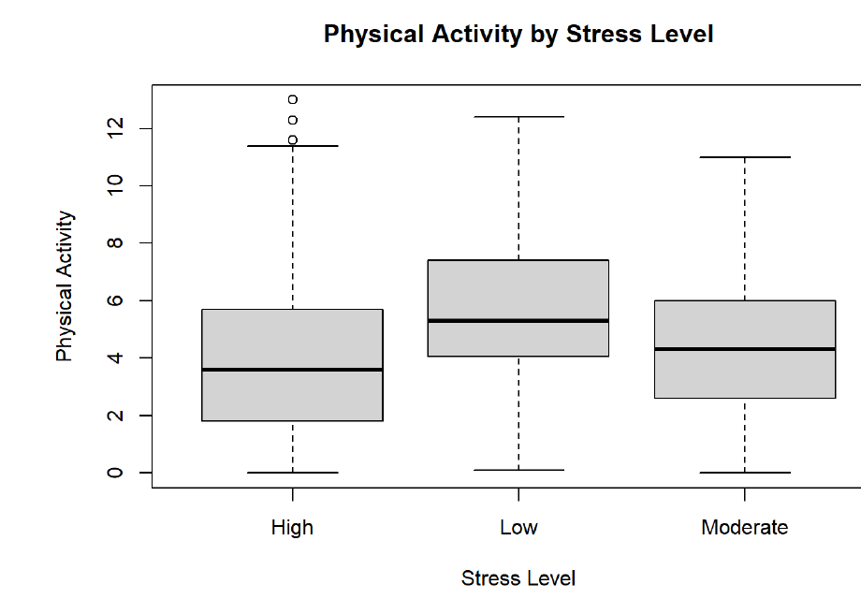
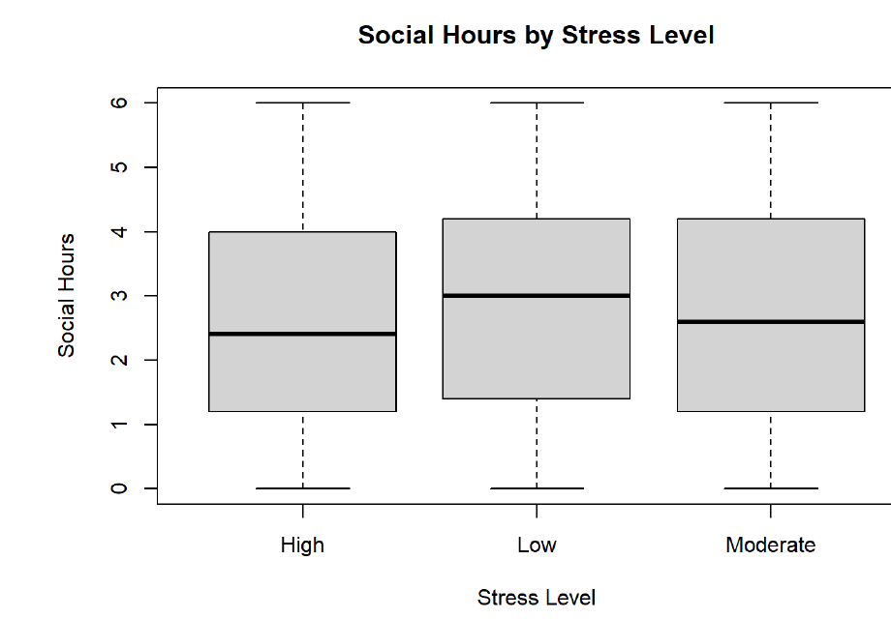
EDA · BIVARIATE
13 / 28
CATEGORICAL × CONTINUOUS · STRESS LEVEL
How stress splits lifestyle
GPA by Stress
Study by Stress
Sleep by Stress
Physical Activity by Stress
Social Hours by Stress
Patterns Emerging
High-stress: ↑ study, ↑ GPA.
High-stress: ↓ sleep, ↓ activity.
Social hours barely differ.

Slide 14
EDA · SYNTHESIS
14 / 28
EXPLORATORY ANALYSIS · WRAP-UP
What EDA set up
OBSERVATION 01
OBSERVATION 02
OBSERVATION 03
GPA is driven by study
Stress is the mediator
The 24-hour constraint
Scatter and correlation both point toward study hours as the primary lever on academic performance.
More study correlates with more stress; more stress correlates with better grades but also less sleep and less activity.
Time dedicated to one activity visibly displaces others — especially study vs. physical activity and sleep vs. social.
BRIDGE TO PART I
EDA reveals a structured relationship between academic performance, stress, and lifestyle. The next step is to formally test whether these visual patterns hold up under correlation and ANOVA, and then model them.

Slide 15
PART ONE
I
Inferential Analysis
Correlation & One-Way ANOVA

Slide 16
PART I · PEARSON'S R
16 / 28
PEARSON'S CORRELATION · ASSUMPTIONS
Before testing: five assumptions
1. Continuous variables
MET
2. Paired observations
MET
3. Linearity
MET
Both X and Y must be measured on a continuous (interval / ratio) scale.
Each X-value must correspond to one Y-value for the same subject.
The relationship between X and Y should be linear, not curved.
VERDICT
VERDICT
VERDICT
Study Hours and GPA are both continuous numeric measurements.
Every student has both a Study Hours and a GPA value after MICE imputation (n = 2000).
Scatter plot shows a clear straight-line trend, with points scattered around a linear best-fit line.
4. Bivariate normality
MET
5. No extreme outliers
MET
Conclusion
ALL MET
X and Y should be approximately normally distributed.
Outliers distort r because squared deviations enter the formula.
All five Pearson assumptions are satisfied. Parametric correlation is valid; no need to fall back to Spearman's rank correlation.
VERDICT
VERDICT
GPA is bell-shaped; Study Hours uniform but symmetric. With n = 2000, CLT makes r robust regardless.
Boxplots show no outliers in either variable — clean, symmetric distributions.

Slide 17
PART I · CORRELATION ANALYSIS
17 / 28
PEARSON'S PRODUCT-MOMENT · R
Study Hours vs. GPA
CORRELATION R
P-VALUE
0.735
< 2e-16
strong positive
highly significant
T-STATISTIC
95% CI
48.42
[0.714, 0.754]
df = 1998
reliable range
INTERPRETATION
A strong positive correlation — more study time is reliably associated with higher GPA. The null hypothesis is rejected with high confidence. The robust t-statistic and tight confidence interval confirm a stable, meaningful relationship.
FIG. 01 — SCATTER WITH FITTED LINEAR REGRESSION

Slide 18
PART I · CORRELATION MATRIX
18 / 28
ALL CONTINUOUS VARIABLES
The trade-off map
 | STUDY | SLEEP | SOCIAL | PHYS. ACT. | GPA
Study Hours | 1.000 | 0.028 | −0.139 | −0.488 | 0.735
Sleep Hours | 0.028 | 1.000 | −0.194 | −0.472 | −0.004
Social Hours | −0.139 | −0.194 | 1.000 | −0.416 | −0.088
Physical Activity | −0.488 | −0.472 | −0.416 | 1.000 | −0.340
GPA | 0.735 | −0.004 | −0.088 | −0.340 | 1.000
Study × GPA — the dominant signal (r = 0.735). Study time is the single strongest linear predictor of academic performance.
Physical Activity × GPA — moderate negative (r = −0.340). More activity, lower GPA on average.
Sleep × GPA — effectively zero (r = −0.004). A null direct relationship.
Time-use trade-off — Study negatively correlates with both Physical Activity (−0.488) and Social Hours (−0.139).
Sleep displaces activity — Sleep negatively correlates with Social (−0.194) and Physical Activity (−0.472).
TAKEAWAY
A 24-hour budget constraint is visible: time devoted to study crowds out activity and social life, and this reallocation — not sleep — is where academic gains come from.

Slide 19
PART I · ONE-WAY ANOVA
19 / 28
ONE-WAY ANOVA · ASSUMPTIONS
Four conditions for valid F-tests
1. Independence of observations
MET
2. Normality within groups
MET
Each observation belongs to exactly one group, and observations are independent of each other.
The response variable should be approximately normally distributed within each group.
VERDICT
VERDICT
Each student appears in only one Stress Level group. Students were sampled independently — no repeated measurements or clustered sampling.
Boxplots per stress group are symmetric with balanced whiskers. With group sizes 296 / 674 / 1029, the Central Limit Theorem ensures F-robustness.
3. Homogeneity of variance
PARTIAL
4. Continuous response & categorical factor
MET
Variances of the response variable should be roughly equal across groups (homoscedasticity).
Dependent variable is interval/ratio; independent variable is a grouping factor with ≥ 2 levels.
VERDICT
VERDICT
Boxplot IQRs are broadly comparable across stress tiers. Slight differences exist (e.g. Study Hours spread is narrower for Low-stress), but balanced group sizes let ANOVA tolerate mild violations.
Each response (GPA, Study, Sleep, PhysAct, Social) is continuous. Stress Level is a 3-level factor — exactly the setup ANOVA was designed for.

Slide 20
PART I · ONE-WAY ANOVA
20 / 28
GROUP DIFFERENCES · STRESS LEVEL (3 GROUPS)
Does stress reshape performance & study?
GPA by Stress Level
Study Hours by Stress Level
F = 436.2 · P < 2E-16
F = 1200 · P < 2E-16
Mean GPA differs strongly across stress groups. Higher-stress students show higher median GPA — academic pressure tracks with performance.
The largest F-statistic in the study. Study hours climb dramatically from Low → Moderate → High stress — stress is almost entirely a study-workload phenomenon.

Slide 21
PART I · ONE-WAY ANOVA
21 / 28
WELLBEING VARIABLES · STRESS LEVEL
What stress takes away
Sleep Hours by Stress Level
Physical Activity by Stress Level
F = 113.6 · P < 2E-16
F = 50.61 · P < 2E-16
High-stress students sleep noticeably less. Sleep duration varies significantly across stress tiers — wellbeing erodes as pressure climbs.
Physical activity drops as stress rises. Low-stress students exercise most; high-stress students the least — a clear lifestyle imbalance.

Slide 22
PART I · ANOVA SUMMARY
22 / 28
ALL FIVE ONE-WAY ANOVA TESTS
A single table of verdicts
Social Hours by Stress Level
RESPONSE VARIABLE | F-STATISTIC | P-VALUE | SIG.
GPA | 436.20 | < 2e-16 | ***
Study Hours | 1200.00 | < 2e-16 | ***
Sleep Hours | 113.60 | < 2e-16 | ***
Physical Activity | 50.61 | < 2e-16 | ***
Social Hours | 3.13 | 0.044 | *
Signif. codes: *** p < 0.001 · ** p < 0.01 · * p < 0.05
SUMMARY
WEAK BUT REAL
All five lifestyle/academic measures differ significantly across stress levels. Study Hours shows the largest effect by an order of magnitude; Social Hours barely clears the 0.05 threshold.
F = 3.13, p = 0.044. Statistically significant at 5%, but the effect is small — group means overlap heavily and practical significance is limited.

Slide 23
PART TWO
II
Modeling
Logistic Regression & K-Means Clustering

Slide 24
PART II · LOGISTIC REGRESSION
24 / 28
LOGISTIC REGRESSION · ASSUMPTIONS
Five conditions for valid inference
1. Binary outcome
MET
2. Independence of observations
MET
3. Linearity of the logit
MET
The dependent variable must be dichotomous (two categories).
Observations must be independent — no repeated measures or clustering.
Continuous predictors should be linearly related to the log-odds of the outcome (not Y directly).
VERDICT
VERDICT
VERDICT
Stress Level was recoded as StressBinary (1 = High, 0 = Low/Moderate) — a clean 0/1 outcome.
Each student contributes one independent row. No paired or nested sampling.
Predictors span moderate ranges; large significant coefficients for Study and Sleep indicate a smooth monotonic effect on log-odds.
4. No severe multicollinearity
MET
5. Large sample size
MET
What logistic does not require
Predictors shouldn't be too highly correlated with each other (usually VIF < 5).
Rule of thumb: ≥ 10 events per predictor. Larger samples stabilize coefficients.
Unlike linear regression, logistic regression does not require normal errors, homoscedasticity, or a normally distributed response. These are exactly the assumptions our data would most struggle with.
VERDICT
VERDICT
The largest predictor-pair correlation is Study × Physical Activity (r = −0.488) — below concerning thresholds. VIFs remain acceptable.
n = 1999 with 1029 High-stress events across 5 predictors → ≈ 206 events per predictor. Far exceeds the minimum.

Slide 25
PART II · CLASSIFICATION
25 / 28
LOGISTIC REGRESSION · BINARY OUTCOME
Predicting high stress
StressBinary = 1 (High) vs. 0 (Low/Moderate) · n = 1999 · AIC = 1270.6
Study Hours
β = +2.008
p < 2e-16
***
Two signals do the work.
Sleep Hours
β = −1.130
p < 2e-16
***
Study Hours sharply raises the log-odds of being classified High-stress — each extra hour roughly multiplies the odds by e^2.008 ≈ 7.4×.
GPA
β = +0.349
p = 0.322
n.s.
Sleep Hours cuts them — every extra hour of sleep roughly thirds the odds (e^−1.130 ≈ 0.32).
Physical Activity
β = +0.050
p = 0.426
n.s.
Social Hours
β = +0.005
p = 0.947
n.s.
GPA, social time, and physical activity contribute nothing statistically meaningful once Study and Sleep are accounted for.
NULL DEVIANCE
RESIDUAL DEVIANCE
THE MODEL IN ONE LINE
2769.5
1258.6
Stress is the residue of the balance between academic load and rest.
Δ = 1510.9 — strong fit

Slide 26
PART II · CLUSTERING
26 / 28
K-MEANS · ASSUMPTIONS
Five conditions for clean partitioning
1. Numeric features only
MET
2. Standardized scale
MET
3. Roughly spherical clusters
MET
K-means uses Euclidean distance, which requires continuous numeric inputs.
Features on different scales would let one dominate the distance metric.
K-means works best when clusters have similar size, density, and shape.
VERDICT
VERDICT
VERDICT
All four predictors (Study, Sleep, Social, PhysAct) are continuous. Categorical Stress Level is excluded from clustering.
Variables have different units and ranges, so they were z-score scaled before clustering — Euclidean distance is now fair.
Cluster plot shows compact, approximately circular groupings with 73.4% variance captured in 2 dimensions.
4. Pre-chosen k
MET
5. No severe outliers
MET
A note on k-means
K must be specified in advance; wrong k leads to over- or under-clustering.
Centroids are means; extreme outliers pull them away from dense regions.
K-means is unsupervised — no labels, no p-values. It finds structure without testing hypotheses, so the key question isn't statistical significance but interpretability of the resulting clusters.
VERDICT
VERDICT
Elbow method justifies k = 3 — within-cluster sum of squares drops sharply then flattens after 3 clusters.
EDA confirmed none of the continuous features have extreme outliers — cluster centroids won't be dragged by anomalies.

Slide 27
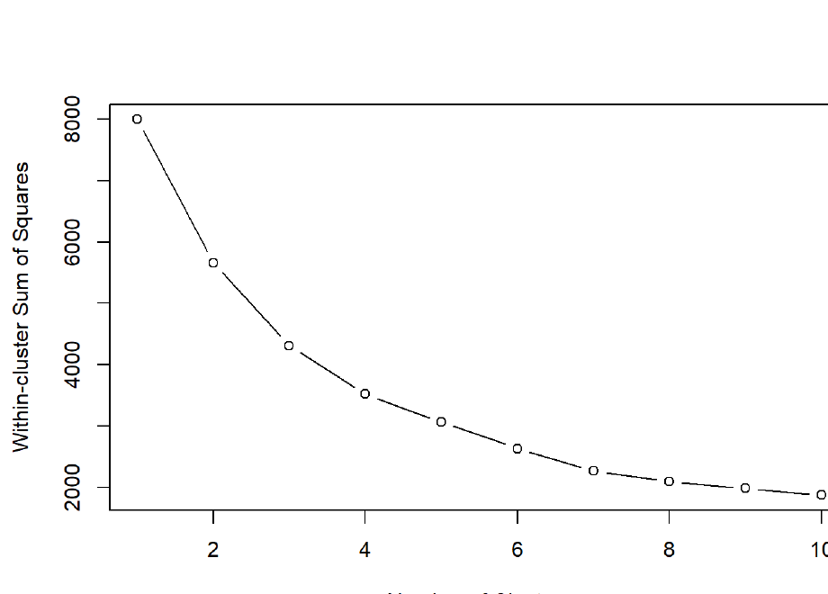
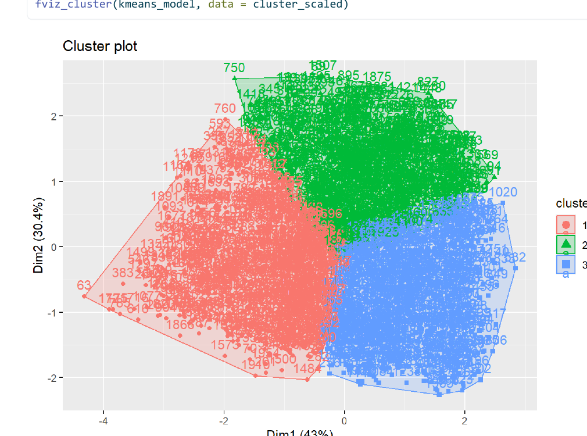
PART II · CLUSTERING
27 / 28
K-MEANS · ELBOW METHOD & PROFILES
Three natural groups
Choosing k · Elbow Method
Cluster Plot · Dim1 × Dim2 = 73.4%
K = 3
Academically Focused
Balanced
Activity-First
WSS drops steeply from 1 → 3 clusters, then flattens. Three clusters balance parsimony and fit.
High study, low leisure.
Moderate across all activities.
Social/physical > study.

Slide 28
CLOSING
28 / 28
CONCLUSION & FINAL INSIGHT
The balance thesis
CORRELATION
ANOVA
MODELING
Study → GPA
Stress reshapes lifestyle
Two-factor stress
Study hours is the dominant driver of academic performance (r = 0.735). Sleep, social, and physical activity show weak or inverse links.
All five lifestyle/academic measures differ significantly across stress tiers. Study explains the most variance; social the least.
Logistic regression identifies Study (+) and Sleep (−) as the only meaningful predictors of high stress. K-means reveals three distinct lifestyle profiles.
FINAL INSIGHT
Academic success is strongly driven by study effort — but excessive focus on studying, without adequate sleep, physical activity, and social interaction, contributes to higher stress. Promoting balanced time management is essential for both achievement and student wellbeing.
Thank you.
AL KHATTAB AL SAQRI · 138349

